Slide 1
Agenda
Web Driver API and Architecture
Browser Navigations
Handling text box
Handling radio button and check box
Handling frames , Popups and Alerts
Capturing screenshot
Actions Class

Slide 2
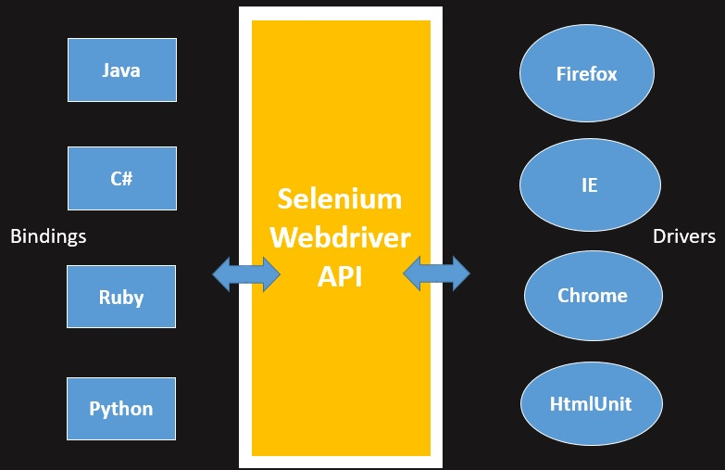
WebDriver API & Architecture

Slide 3
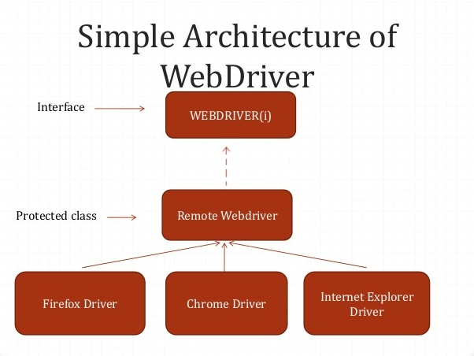

Slide 4
Click() and sendKeys()
Clicking on Buttons
Submit Buttons
Entering Values in Input Boxes
Deleting Values in Input Boxes

Slide 5
Browser Navigations
Navigate To Command
Forward Command
Back Command
Refresh Command
Close
Quit
Switch Between Windows

Slide 6
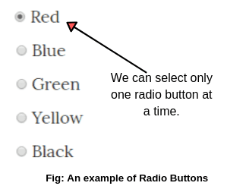
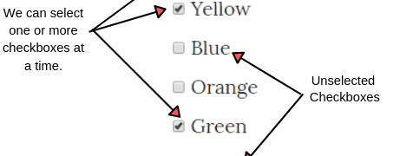
Before performing the click on the Radio buttons or checkboxes we will have to verify
If Radio button or Checkbox is displayed on the webpage
If Radio button or Checkbox is enabled on the webpage
If the default selection of the Radio button or Checkbox
Radio Button & CheckBox

Slide 7
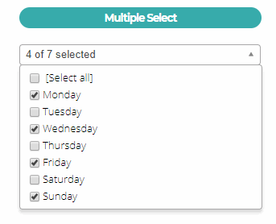
This verification is done using
IsDisplayed()
IsEnabled()
IsSelected()
Action is performed using
.Click() method
Multiple selection in Checkbox

Slide 8
Dropdowns
How to handle drop downs in selenium
Select Class ???
Methods in select class
selectByValue()
selectByIndex
selectByVisibleText()
deselectByValue()
deselectByVisibleText()
deselectByIndex()

Slide 9
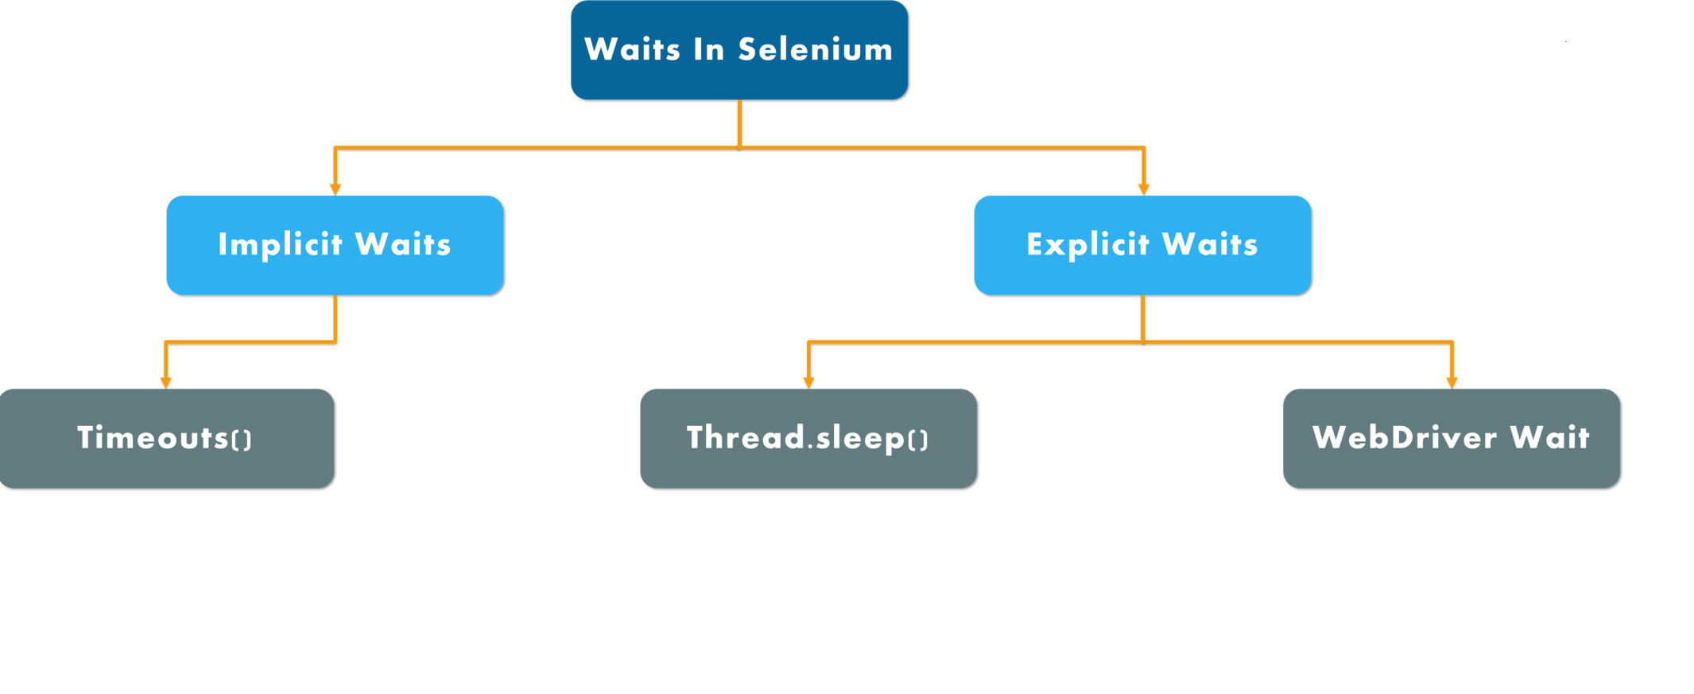
Synchronization

Slide 10
iFrame
What is Iframe?
How to identify the iframe
How to switch over the elements in iframes using Web Driver commands:
By Index
By Name or Id
By Web Element
How to switch back to the Main Frame

Slide 11
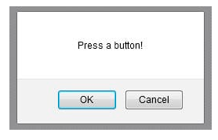
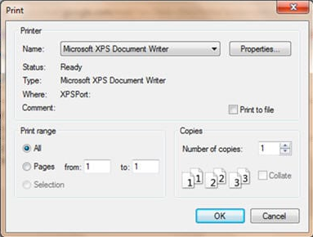
Pop Ups
Web based pop ups
Windows based pop ups

Slide 12
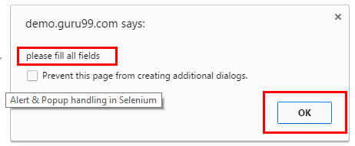
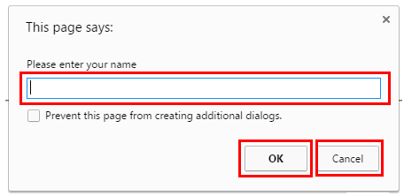
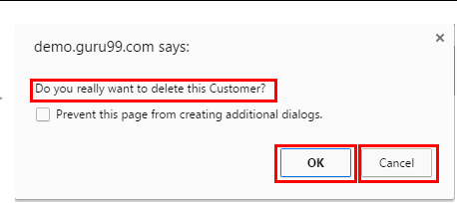
Windows pop-ups or Alerts
Simple Alert Prompt Alert. Confirmation Alert.
Methods to Handle Alerts
switchTo()alert()
accept()
dismiss()
getText()
sendKeys()

Slide 13
Capture Screenshot
Why Screenshot is required in Automation testing?
How to capture Screenshot in Selenium?

Slide 14
Actions Class
What is the Actions class?
How to use actions class in Selenium
Different methods under Actions class
Keyboard interface
Mouse interface

Slide 15
How to use actions class in Selenium
Import actions class package
Instantiate Actions class
Generate actions sequence
Build the actions sequence
Perform actions sequence

Slide 16
Keyboard Interface
SendKeys()
KeyDown()
keyUp()

Slide 17
Mouse Interface
Click()
doubleClick ():
ContextClick()
ClickAndHold()
dragAndDrop(source, target)
dragAndDropBy(source, xOffset, yOffset)
Release()
moveToElement(toElement)

